Slide 1

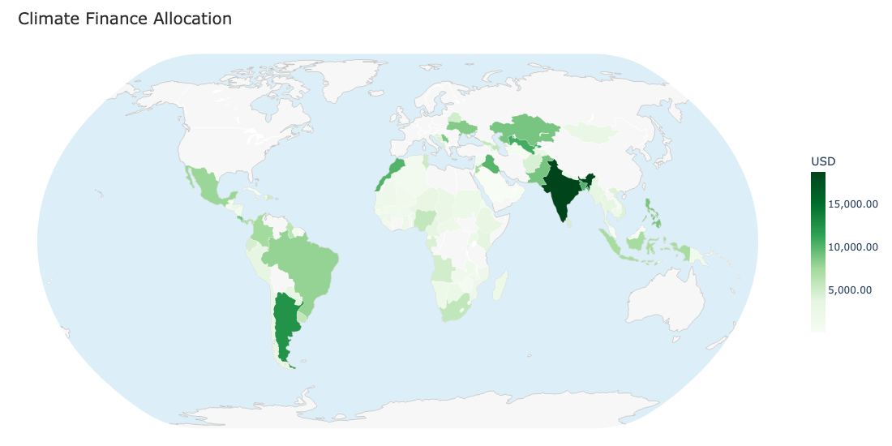
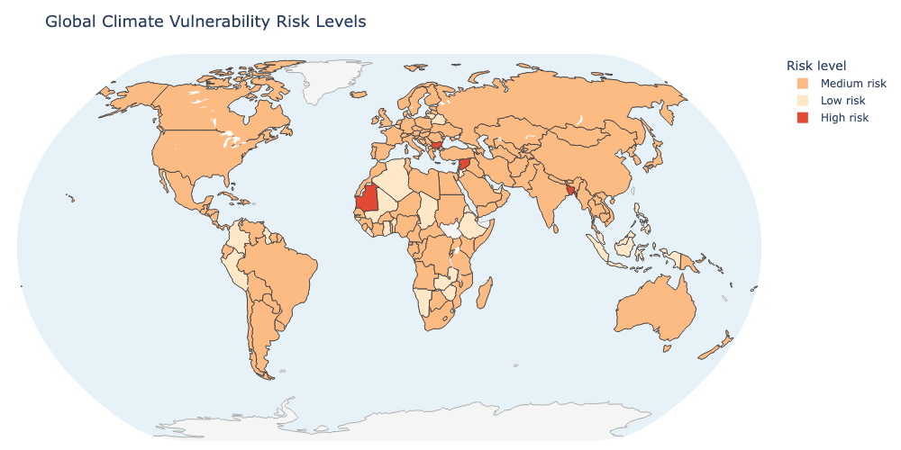
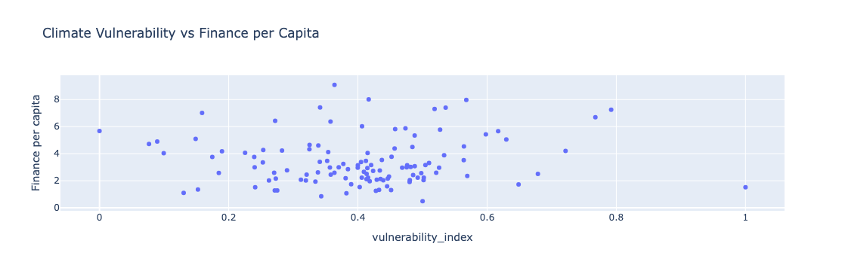
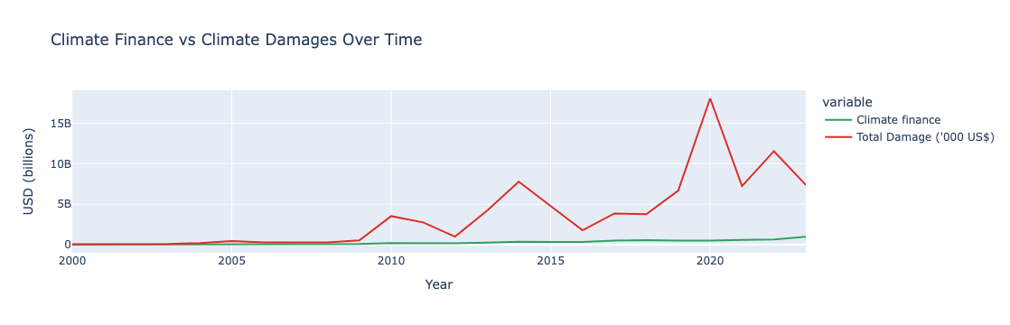
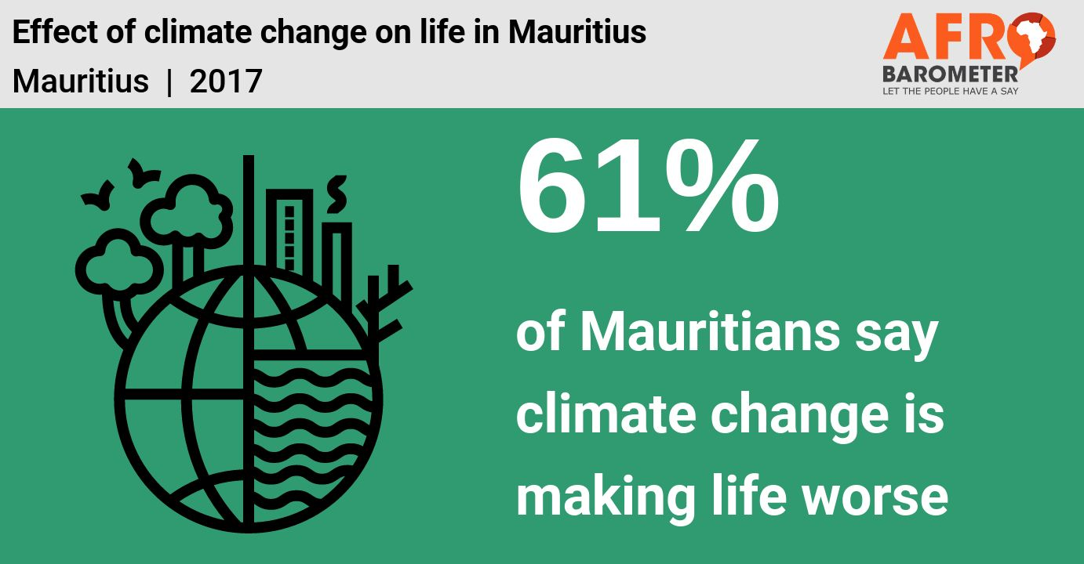
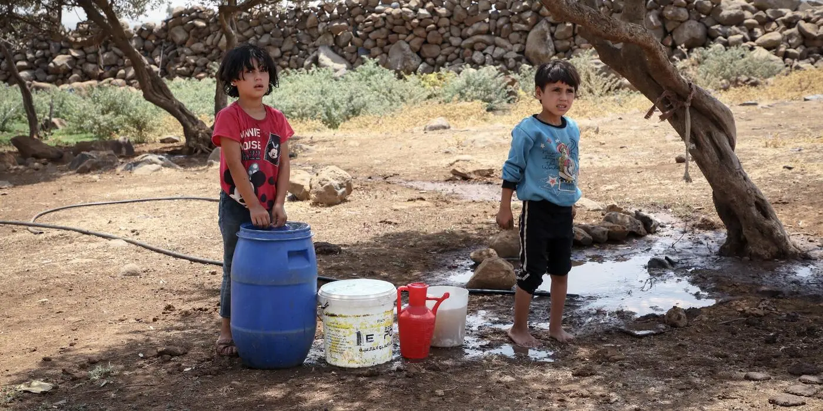
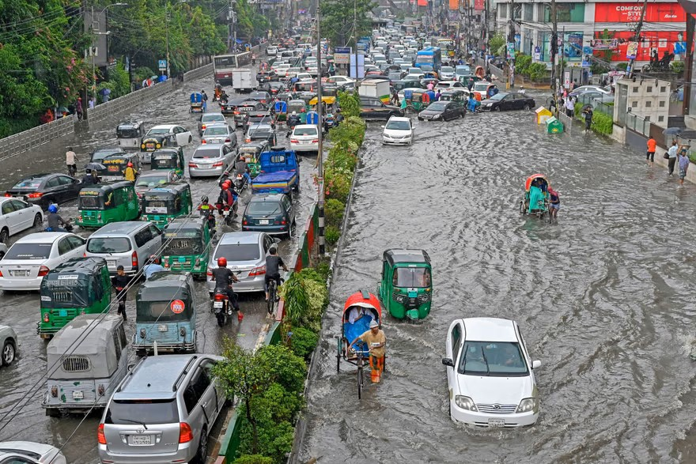
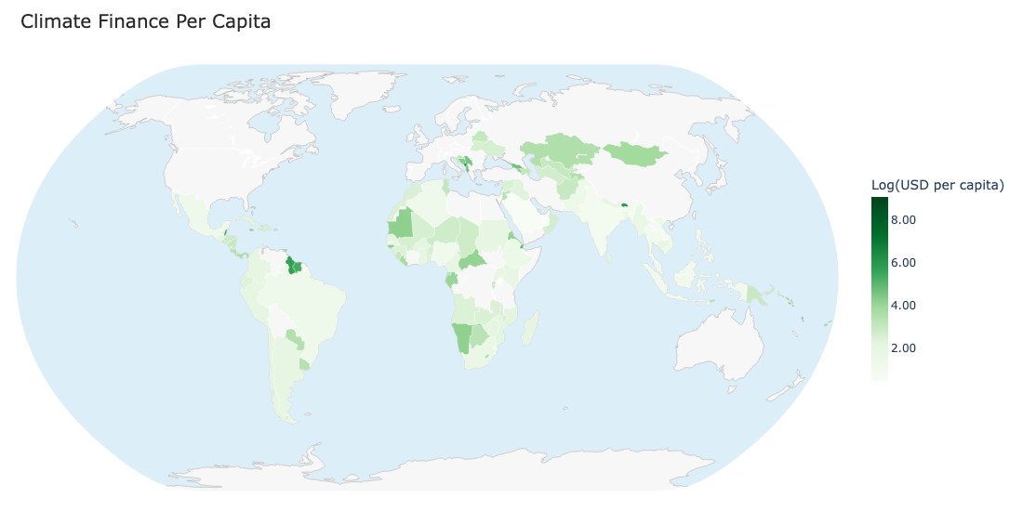
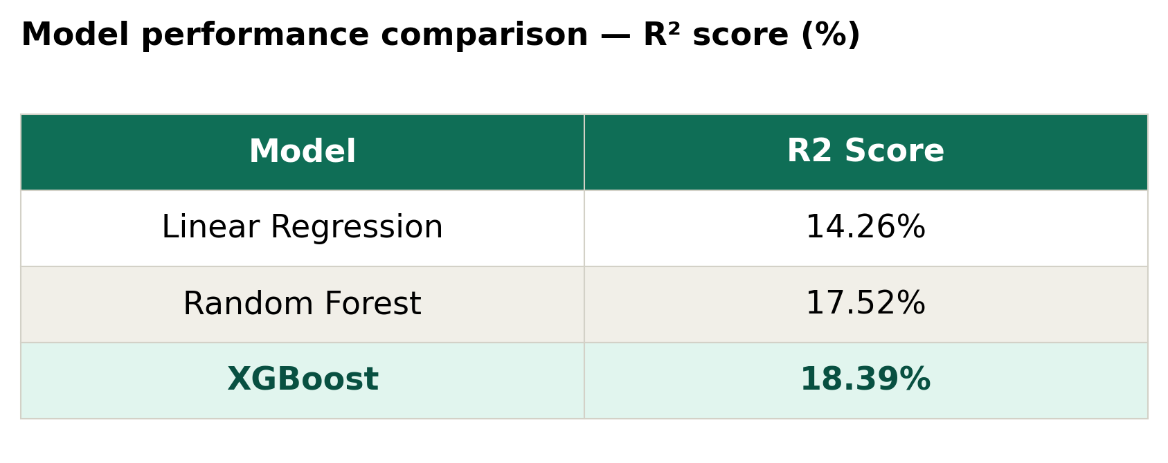
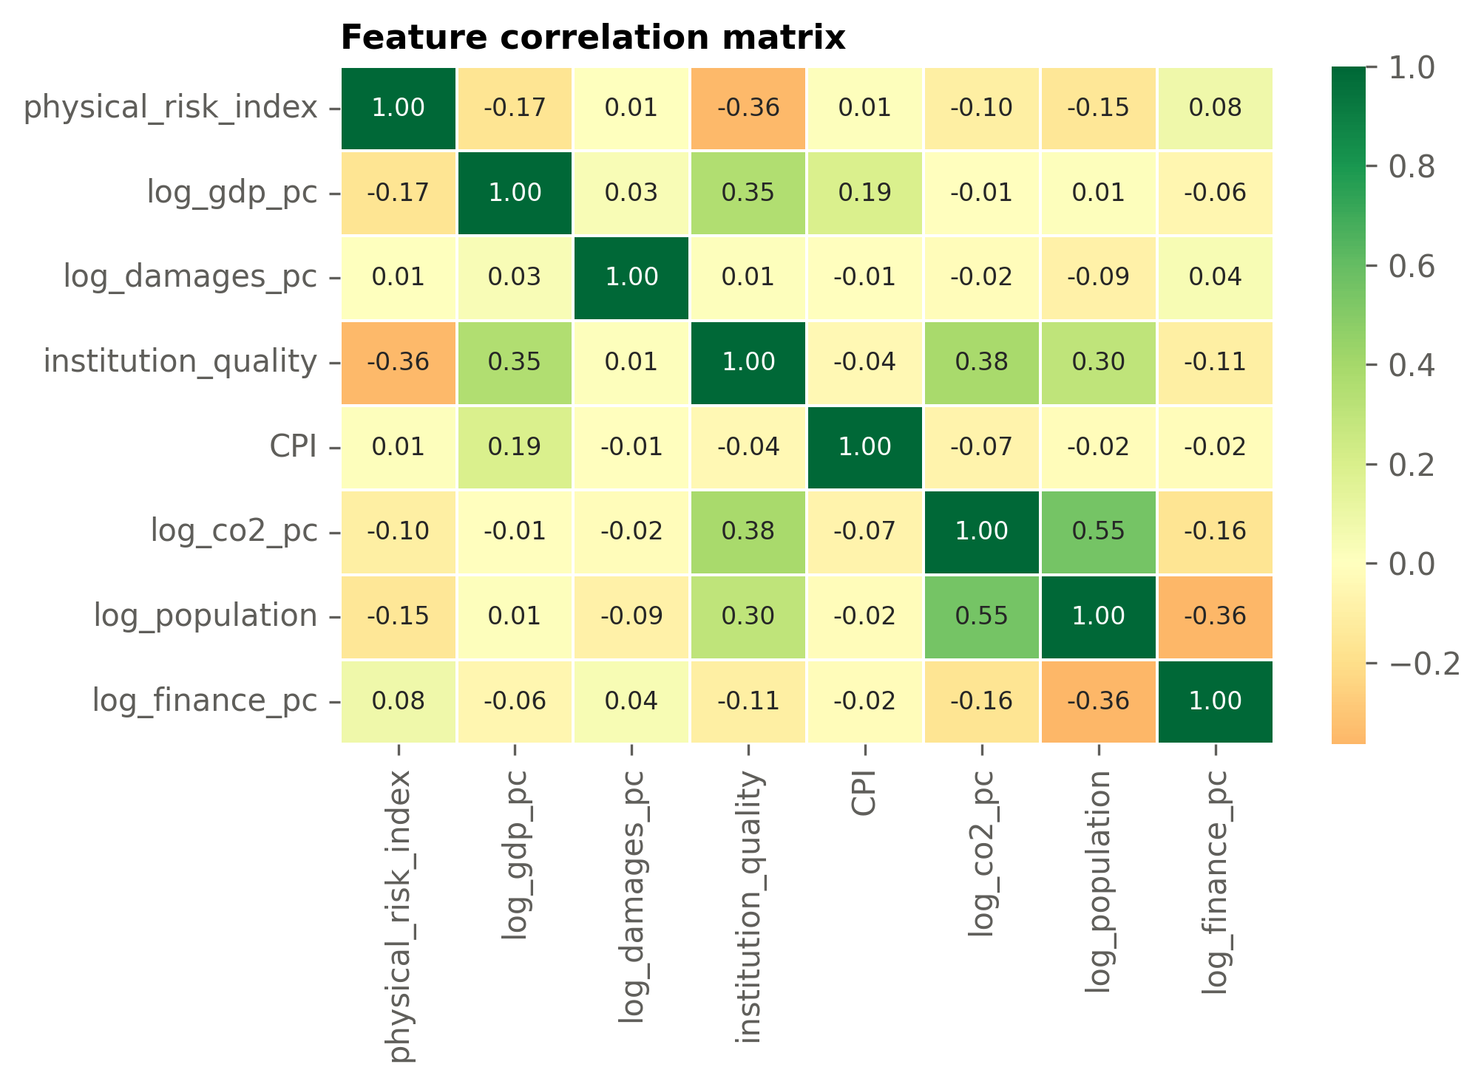
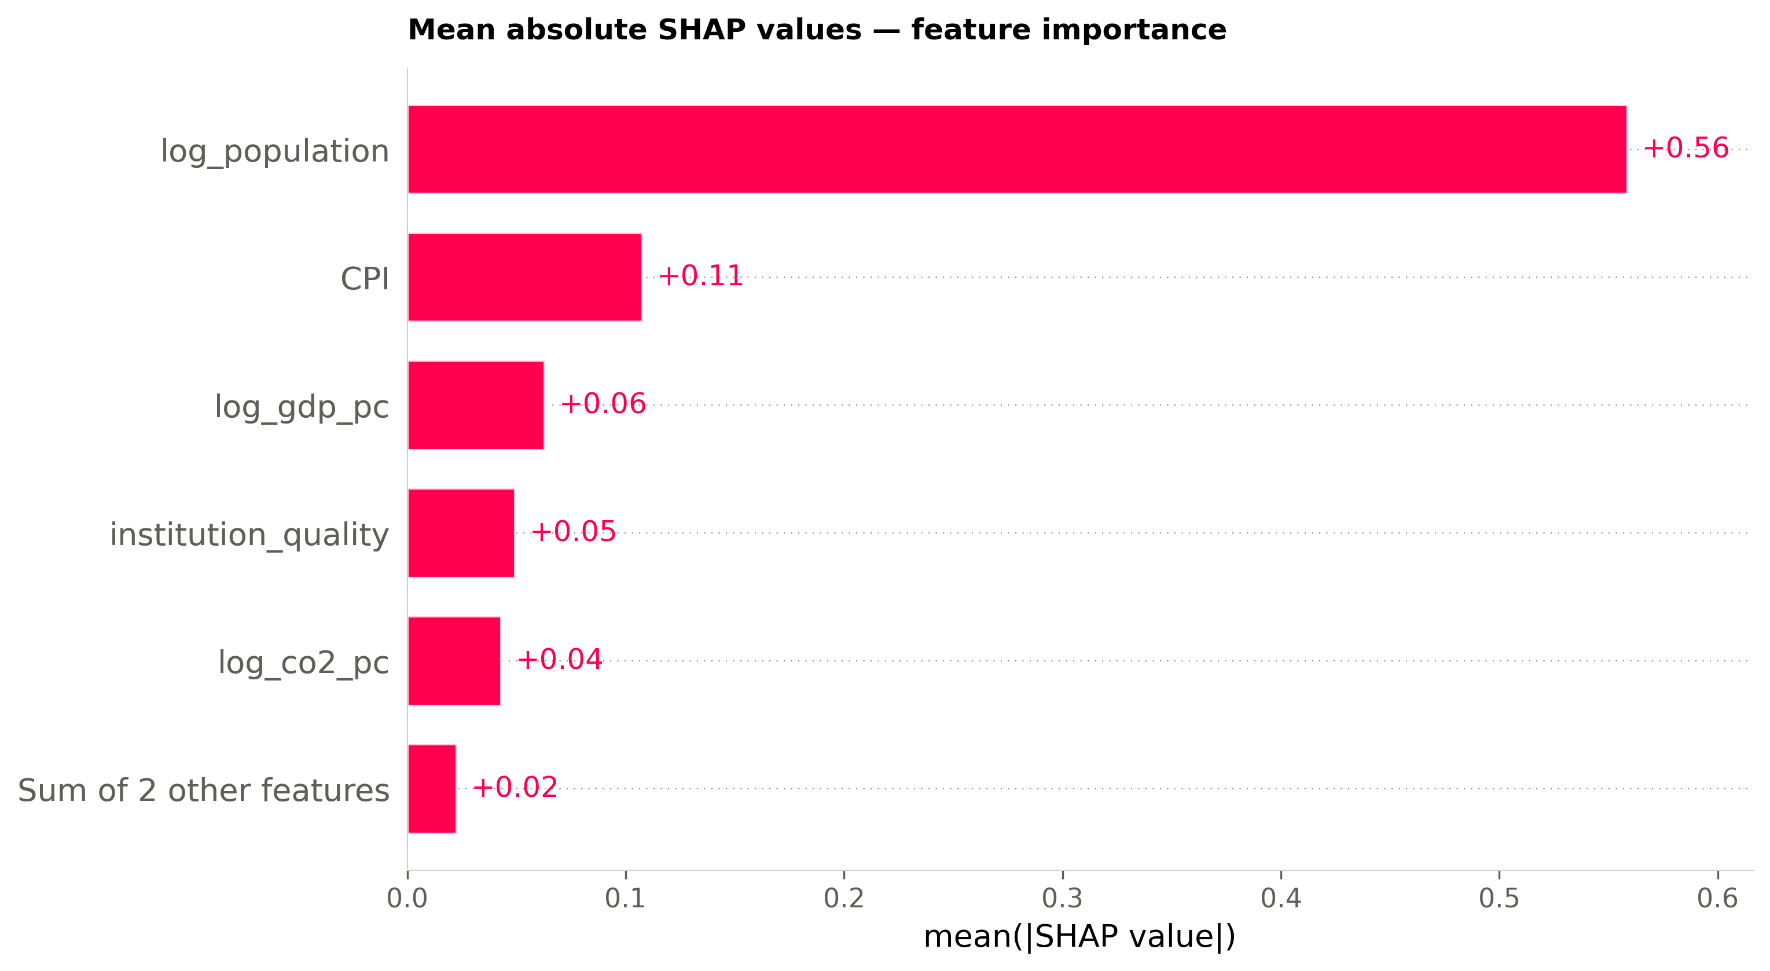
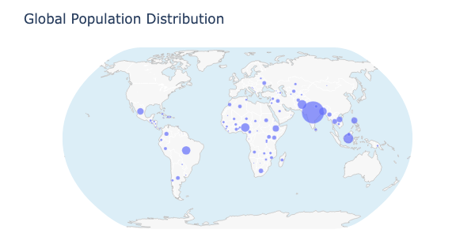
MSC DATA SCIENCE • YORK ST JOHN UNIVERSITY • 2026
Decoding Capital Flow in Climate Finance:
A Machine Learning Analysis of Global Climate Finance Per Capita
Using a panel of 117 countries (2000-2023), this study applies supervised machine learning to test if Need and Readiness factors predicts the allocation of International finance. Random forest and XGBoost models reveal need factors explains only 18% of the capital flow variance.
Module Director: Sangita Pokhrel
Student: Olamilekan John Olowolagba
01 - Introduction
02 – Research question
03 – Data sources
04 - Methodology
Why does Climate finance allocation matter?
Despite developed country pledges, climate finance allocation remain disproportionate, with middle-income countries receiving greater funding than more vulnerable regions such as Sub-Saharan Africa and South Asia.
Does objective climate vulnerability predict finance allocation?
Equitable climate finance should reflect adaptation and mitigation needs. Yet trends in finance flows indicate a weak alignment with objective measures of vulnerability.
Panel dataset: 117 countries, 2000-2023
ND-GAIN country index – vulnerability and readiness
World Bank Open Data – GDP, population, CO₂ per capita
EM-DAT (CRED) – disaster economic losses by country-year
OECD (CRDF) – Climate related development finance by country-year
All sources are open access. Merged on ISO 3166 country-codes.
ND-GAIN scores averaged across all available years for robustness
Supervised Machine Learning
Target: log(climate finance per capita)
7 features: physical risk, population, CO₂ , GDP_PC, damages_PC, Inflation(CPI), and institutional quality
Models: OLS • Random Forest • XGBoost
Evaluation: R²
Importance: Shap Explainer Waterfall plot
Global climate
finance
$1.2T
2023 total
Annual Losses
$2.4B
EM-DAT 2026
Global Exposure
80%
High & medium risk
Climate vulnerability shows a weak relationship with finance allocation, indicating a misalignment in global climate finance.
Key finding: Machine Learning Shows Vulnerability and Risk Plays Limited Role in Finance Allocation
XGBoost outperforms OLR and Random Forest; population, emissions profile, and income are key predictors • N = 117 country-year observations • 2000-2023
05 – Where the money goes
06 – Where the risk is
07 – The mismatch
08 – Trend & Outlook
Geographical concentration of climate finance
Highest risk concentrated in the global south
High-risk nations receive less finance
Several low to medium risk countries, such as Antigua and Barbuda, receive substantially higher mitigation and adaptation finance than higher‑risk countries, including Bangladesh and Mauritania.
The gap between finance and loss is widening
Climate finance is concentrated in South Asia, Europe, and South America.
Fig1: Afro Barometer, 2018
Climate finance remains severely outpaced by climate damages, signalling an urgent need to scale funding to match the true costs of climate impacts.
Fig2: OCHA, 2023
Fig3: The Guardian, 2024
Sub-Saharan Africa, South Asia, and small island developing states carry the highest composite hazard scores for flood, heat, and drought.
10 – Feature Importance – core ML result
09 – Model Performance
Within the limited share of climate finance allocation explained by the model (18%), population is the dominant predictor,
whereas physical climate vulnerability plays a minimal role (2%), indicating a systematic misalignment between finance flows and objective climate risk.
XGBoost achieves highest explanatory power
Population adjustment reveals higher relative allocations to Africa.
Minimal performance gains from non‑linear models imply that unobserved political and institutional dynamics, rather than physical vulnerability, primarily shape allocation outcomes.
Perceived equity depends strongly on the metric used.
Data & Methods | Limitations | Future work | References
Open‑source data were sourced from the World Bank, OECD, EM‑DAT, ND‑GAIN, and the Climate Policy Initiative.
Datasets were merged by country code, country name, and year.
Missing GDP and population data were initially handled using linear interpolation; observations with insufficient data for interpolation were excluded.
Total damages and adaptation and mitigation finance were imputed as zero where no records existed, acknowledging potential model bias. Climate risk was defined as the normalised average of vulnerability and (1 − readiness). Institutional quality was measured as the average of rule of law and control of corruption.
GDP, finance allocations, and damages were converted to per‑capita values and log‑transformed to reduce skewness.
Target variable: log climate finance per capita.
Climate Policy Initiative (CPI) data do not provide country‑level finance breakdowns, as reporting is largely regional; analysis was therefore restricted to OECD (CRDF) finance data.
Annual total damage data contain substantial missing values across countries.
Finance allocations are missing or underreported for several higher‑income countries, including the UK, US, Canada, Australia, and China.
Climate finance aggregates heterogeneous instruments (grants, loans, equity) into a single measure, despite differing allocation logics that models cannot distinguish.
This study is observational; estimated associations cannot be interpreted as causal.
Unobserved factors—such as colonial history, donor–recipient trade relationships, or participation in international climate finance frameworks—may influence allocation patterns attributed to GDP or climate risk.
Expand disaster damage coverage using alternative sources such as Swiss Re Institute natural catastrophe data to improve robustness of damage estimates.
Apply machine‑learning methods to further identify strategic and political drivers influencing climate finance allocation and wealth effects.
Separately model public and private climate finance to test whether public finance responds more strongly to physical climate risk than return‑driven private capital.
Examine how different financing purposes (e.g. adaptation vs mitigation) reflect donor priorities and global climate finance governance frameworks.
Assess how post‑COVID‑19 and conflict‑related economic shocks have altered climate finance sources, volumes, and allocation patterns.
Global Landscape of Climate Finance (GLCF), 2023
ND-Gain Country Index, 2025
Notre Dame University, 2023
World Bank Open Data,. 2024
EM-DAT – The international disaster database, 2024
OECD – Climate and Development Finance Data, 2023

